Slide 1
graph of modulo size per number of bins

Slide 2
zig zag shape
we use even and odd number of bins
at the odd case we have a quant at the zero

Slide 3
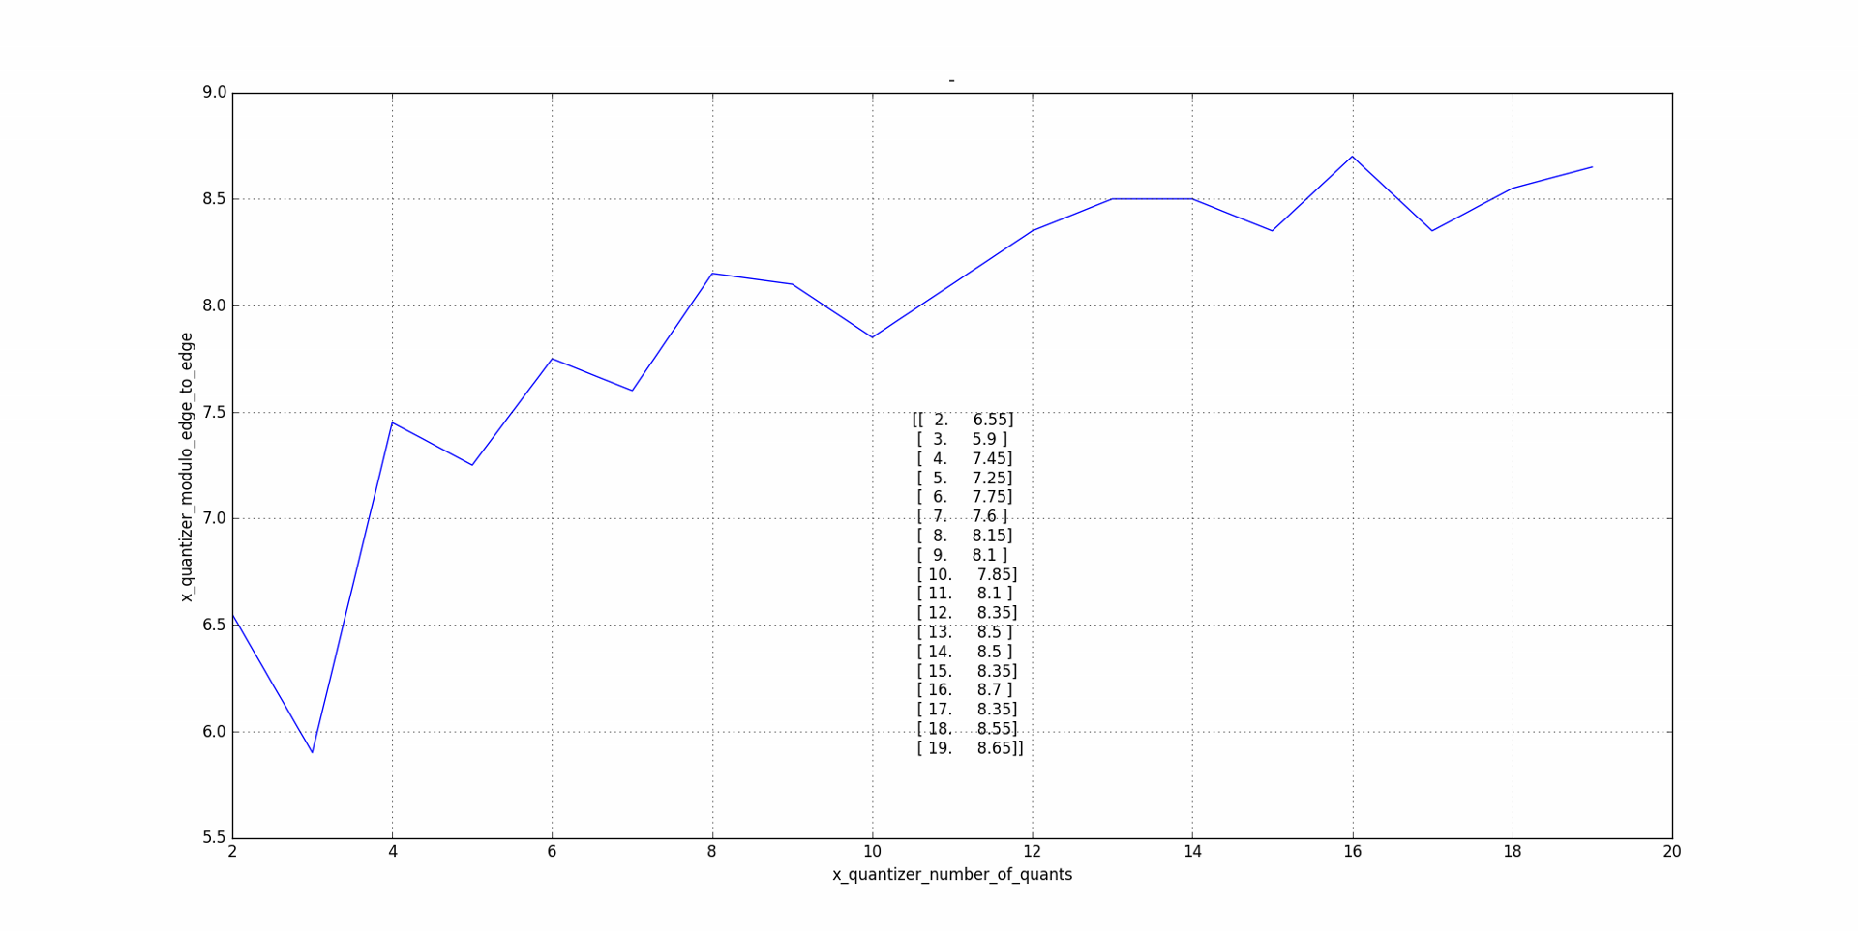
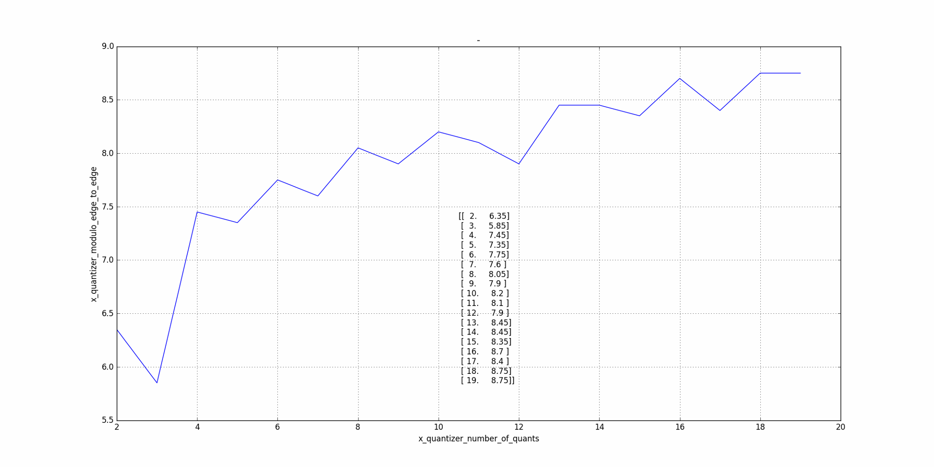
w and wo alpha
without alpha we get more of the zigzag shape
with alpha
without alpha

Slide 4
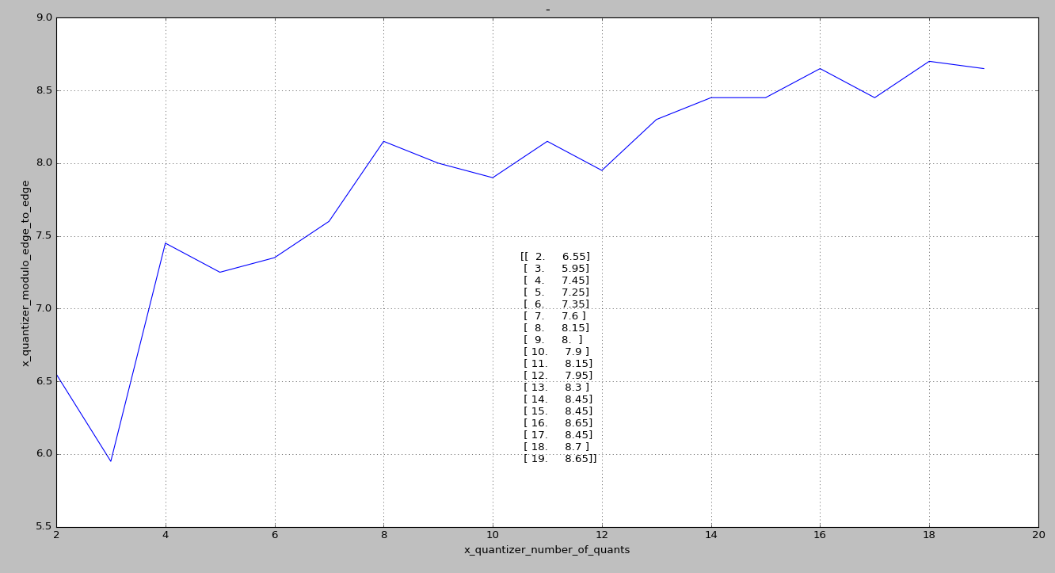
example modulo size per number of bins, with alpha
we expect those points to be higher
for example, we expect bin 6 to be 7.8 instead of 7.3

Slide 5
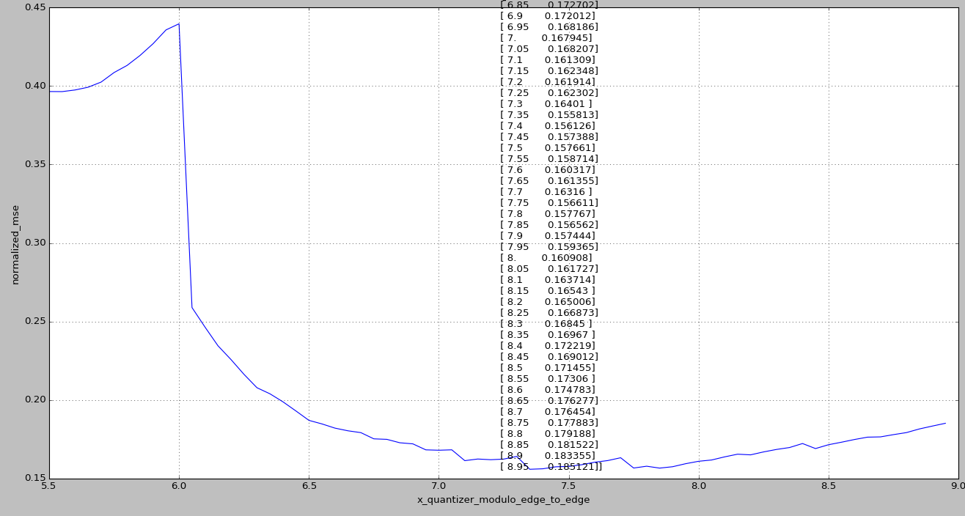
let see mse results per modulo size, when number of bins is 6
each point at this graph made from 5e7 samples

Slide 6
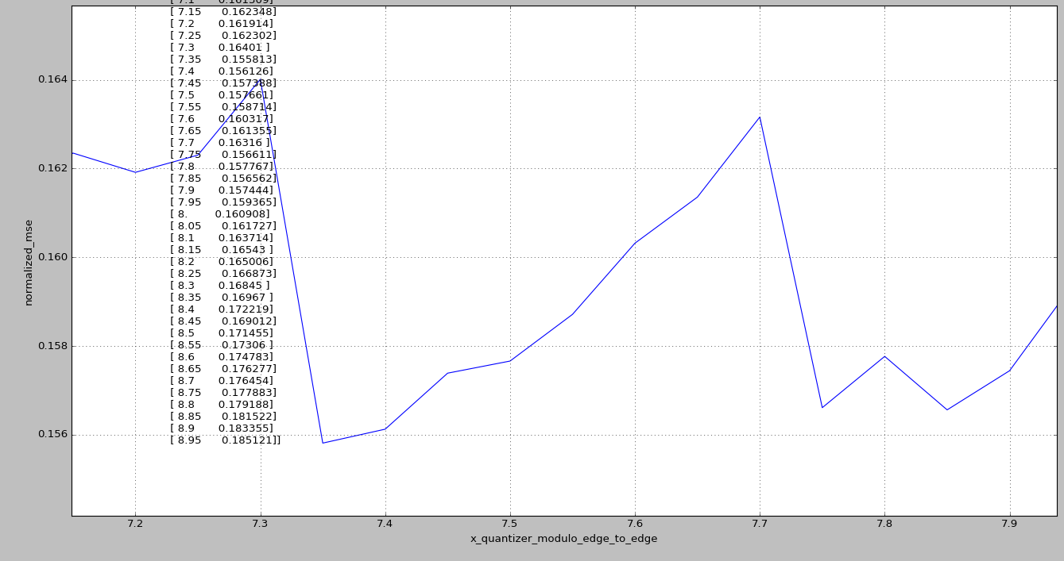
zoom in – we see a lot of noise, which made the sim to take modulo size of 7.3 instead of 7.8

